Slide 1

Analyzing coffee store data
By chukwumobi chizaram divine

Slide 2
PROJECT PLAN
INTRODUCTION
METHODOLOGY
STATEMENT OF PROBLEMS
DATA PREPERATION
OBSERVATION & CONCLUSION
REFERENCE
VISUALIZATION

Slide 3
INTRODUCTION
Coffee: A flavorful beverage brewed from roasted coffee beans, enjoyed for its distinct taste and energizing qualities. It encompasses various types of drinks, including espresso-based creations, and holds a significant place in culinary culture and social rituals.

Slide 4
METHODOLOGY
MICROSOFT EXCEL
FOR DATA CLEANING.
POSTGRESQL
TO EXTRACT THE DATA.
PYTHON
PANDAS, NUMPY AND MATPLOTLIB FOR ANALYSIS.
POWER BI
FOR VISUALIZATION.
POWERPOINT
FOR PRESENTATION.

Slide 5
Statement of problem
In the dynamic realm of coffee stores, the focus of this analysis is to extract valuable insights from coffee_csv dataset. Our Objectives include:
Most Rated and Reviewed Place Types: By scrutinizing the ratings and reviews attributed to different place types, I aim to uncover the most highly regarded and reviewed coffee store categories. This information can provide a deeper understanding of customer preferences.
Top Five Place Names: I will identify the top five coffee store names that have generated the highest number of reviews. This exploration will extend to evaluating the total ratings and reviews received by these establishments.
Dine-In, Delivery, and Takeout Options: Delving into the dining experience, I will quantify the number of coffee stores that offer dine-in, delivery and takeout facilities and differentiate them from those that do not.

Slide 6
Data preparation and cleaning i
During the initial phases of my analysis, I meticulously reviewed the dataset for potential inconsistencies and discrepancies. This involved thorough checks to ensure data integrity. For instance, I took steps to address discrepancies such as varying Boolean values. This proved beneficial during my Power BI visualization stage, enhancing the utility of functions like CALCULATE and FILTER.
To ensure data accuracy, I meticulously aligned all data types across the board. This process was crucial to guarantee seamless interactions between different data components. Furthermore, I conducted a comprehensive assessment to identify and rectify any missing values that could potentially impact the accuracy of my analysis.
Among the key actions I undertook was addressing missing values in the 'Rating' column. These instances were skillfully replaced with the value '0'. This strategic decision enables me to incorporate these observations into calculations without undue influence on metrics like averages and totals.

Slide 7
Data preparation and cleaning ii
For the 'Reviews' column, I applied a nuanced approach. I replaced missing values with the median value of 271.5. This choice serves to prevent any undue skewing of calculations, ensuring a balanced and accurate representation of insights.
Regarding the 'Dine-In,' 'Delivery,' and 'Takeout' options, I opted to replace any null values with 'False.' This strategic choice stems from the assumption that if an option is not explicitly indicated as 'True,' it is more fitting for it to be considered 'False.'
Through these meticulous data preprocessing steps, I've laid a solid foundation for a robust and insightful analysis. The decisions made ensure that my subsequent visualizations and interpretations are built upon reliable and meaningful data."

Slide 8
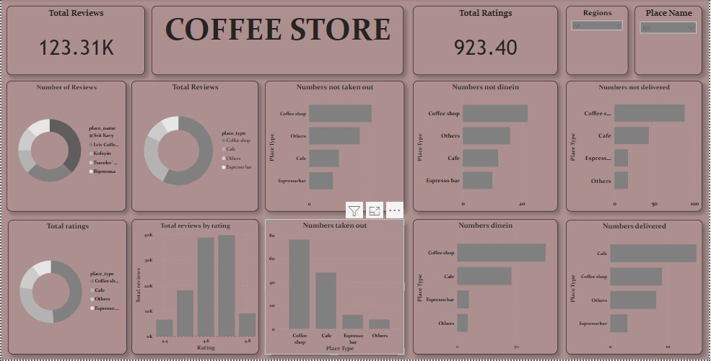

Slide 9
REFERENCE: dataset From data camp

